Slide 1
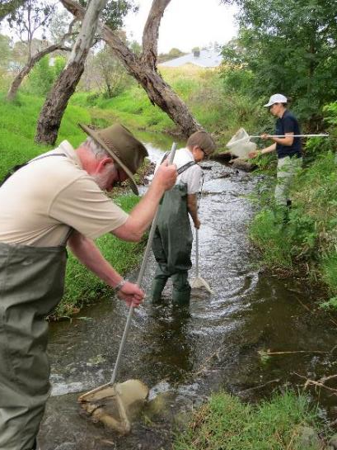
Citizen Science Empowering the Community
in SA Murray-Darling Basin
Sylvia Clarke and Sally Maxwell
Department of Environment, Water and Natural Resources
Natural Resources SA Murray-Darling Basin & Science and Information Branch
Notes:
Also presenting with me is Sally Maxwell, who puts the science in our citizen science Waterwatch program. She is an aquatic ecologist with DEWNR and has been instrumental in reinvigorating the SA Murray-Darling Basin Waterwatch program. I also want to acknowledge Sylvia Clarke who has done the majority of the work that I will talk about today and Janet and Bruce Brooks of Finniss Catchment group, two incredibly committed and enthusiastic Waterwatch volunteers.

Slide 2
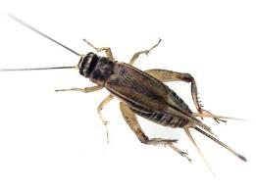
SA Murray-Darling Basin Review
‘Traditional’ Waterwatch program since 1990s
Water quality parameters
Macroinvertebrates to order
Produced government style Catchment Reports - 2015/2016
Presented to government and community…
Notes:
The Waterwatch program has now been running in the SA Murray-Darling Basin for 25 years. It was part of the original National WaterWatch program, which was very popular, and well resourcedan early citizen science program. Participants collected water quality data from rivers and streams.
When the national project ended, the SA Murray-Darling Basin board continued the program as ‘community surface water quality monitoring’ with excellent participation by community, mostly as catchment groups and schools
Was resources by BoM and Data was sent to BOM

Slide 3
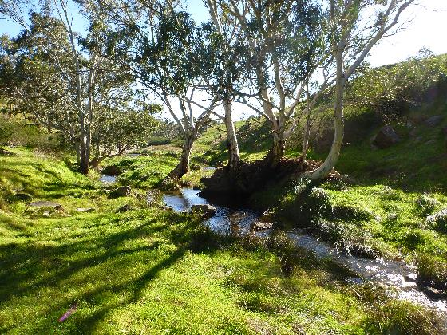
SA Murray-Darling Basin Review
Who will use this data and for what purpose?
What is useful for research, planning and policy makers?
What level of verification is acceptable?
Was a real need for data
Regional resource condition
Water Allocation Planning
Flows for the Future project

Slide 4
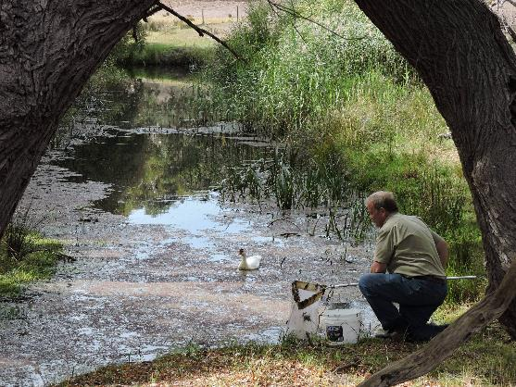
SA Murray-Darling Basin Review
Who will use this data and for what purpose?
What information does the community want?
What do they have the capacity (skills and time) to undertake (alone or with expert supervision)?
Was a real need for data
Site & catchment level health
pollution, extraction and riparian restoration

Slide 5
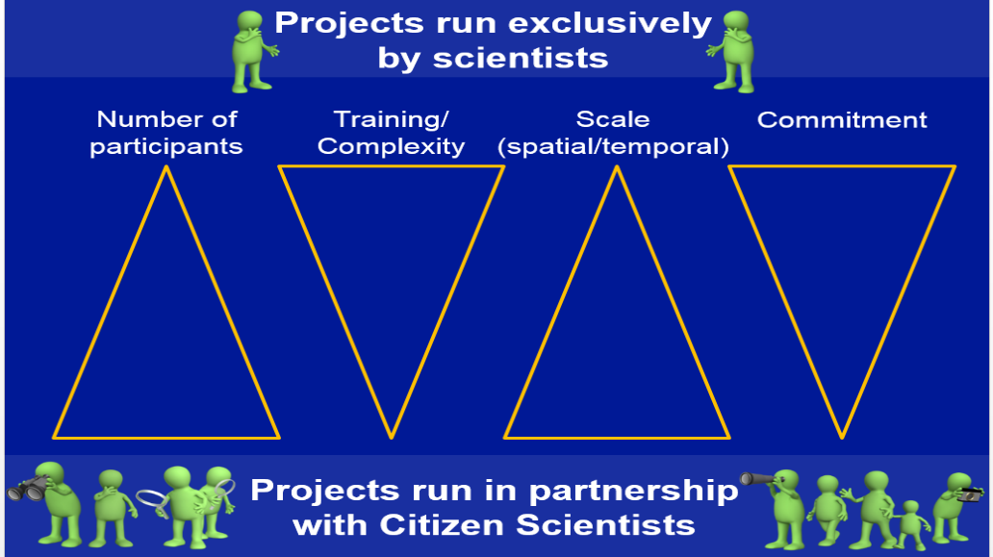
Model for Citizen Science Projects
Need to be here
Waterwatch was here
Co-design & Co-monitoring Model
Notes:
You may have seen this common model for citizen science projects.
In the past our Waterwatch program engaged with a large number of volunteers, with little input from scientists, for whom (in theory) the data was being collected.
Our goal was to partner with all of the involved parties to develop a model which still had excellent education and engagement outcomes but very importantly would produce useable data for research, planning and reporting purposes.

Slide 6
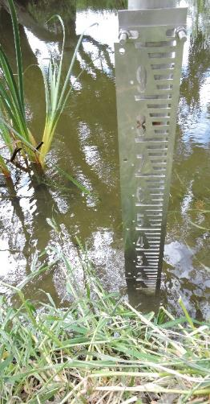
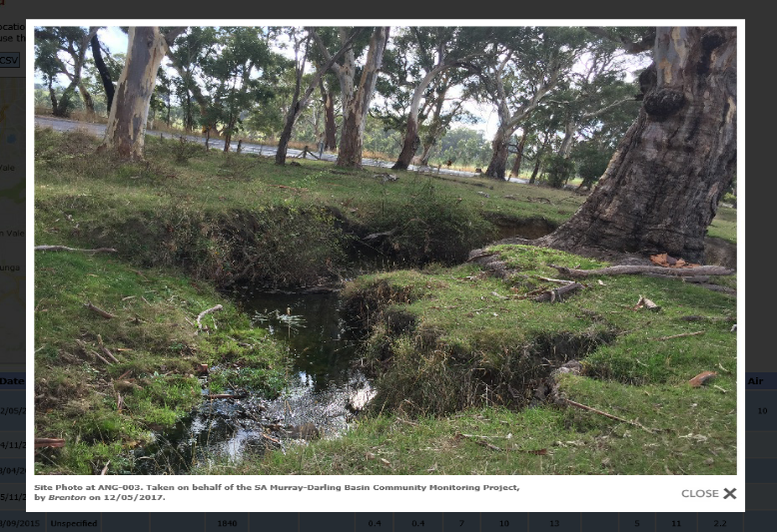
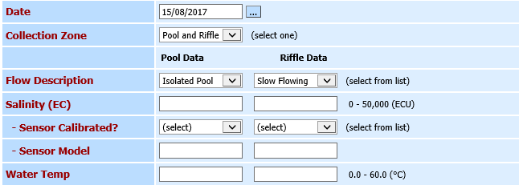
Part 1 – Simplify Waterwatch
Water quality - Salinity only
Flow recordings –Gaugeboard
Photopoints
Database
Notes:
The first step to reinvigorate our Waterwatch program was to partner with scientists from DEWNR Science and Information, SA Water and EPA to identify how we could ensure community collected data has a high level of QA/QC and therefore be useful for research and planning.
This review resulted in a simplification of the community monitoring Waterwatch program. We now collect fewer parameters including salinity, flow, and water temperature. Photopoints and gaugeboard were installed and photos and readings recorded regularly.
New database with scientist-recommended fields for preferred volunteer collection marked in red

Slide 7
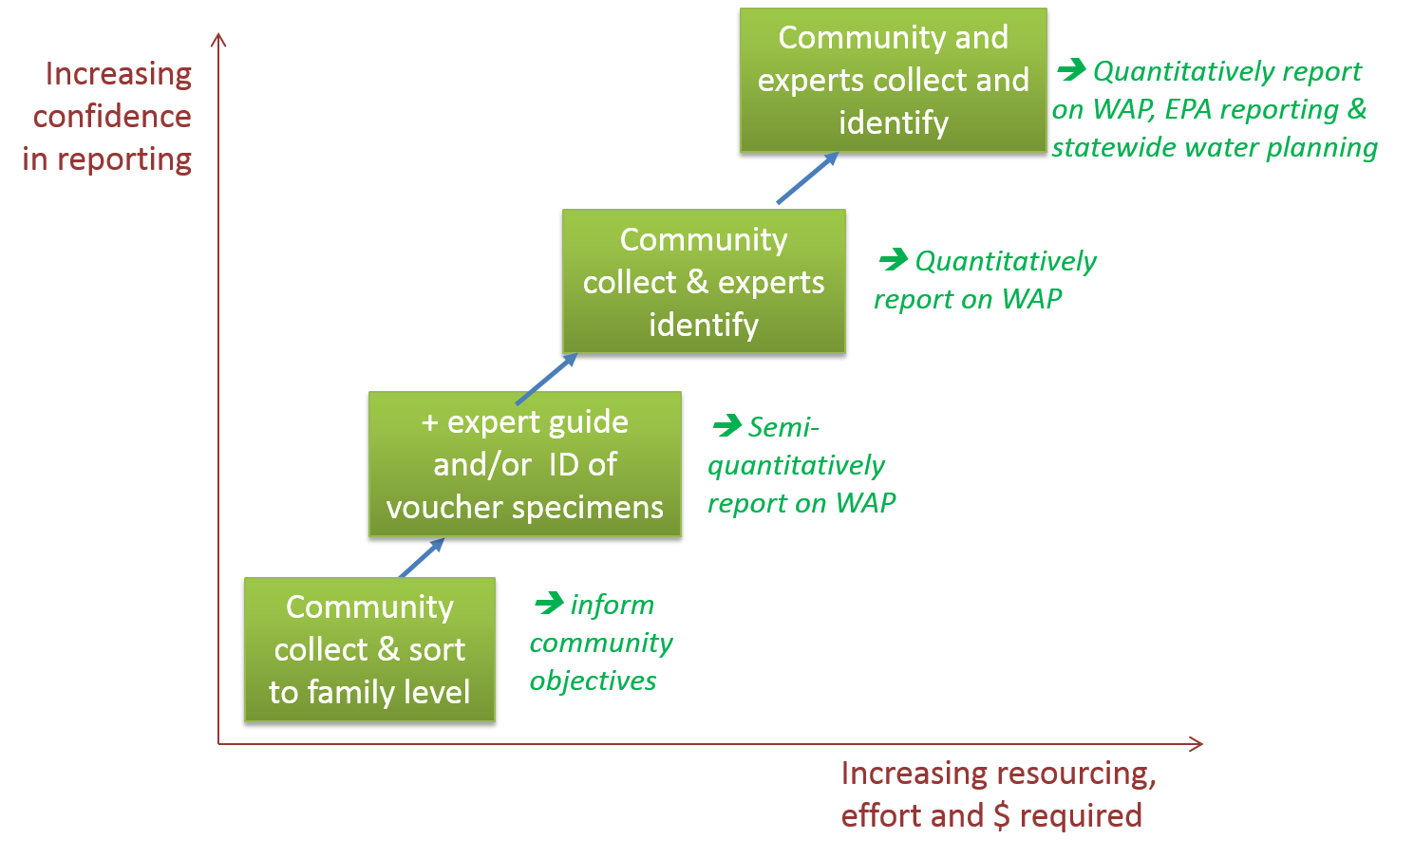
Part 2 - Macroinvertebrates
bringing scientists and community together
Waterbug
BioBlitz!
Increasing effort
Notes:
The second step was to establish a program where community Waterwatchers and scientists could come together to collect data, and discuss the project.
We looked at several different models and the data that would be available from each method.
The community had expressed very strong views that they wanted the data to be useful not only as an educational tool.
We looked at ways of increasing scientist confidence in community collected data and had several a trial runs which included collecting multiple different indicators which had been used in water planning previously.
The community members had a strong interest in macrioinvertebrates. Fortunately macros also have a long history in ecological condition assessment and so they were chosen as the most appropriate indicator moving forward.
And that is how we came to initiate the Waterbug Bioblitz!

Slide 8
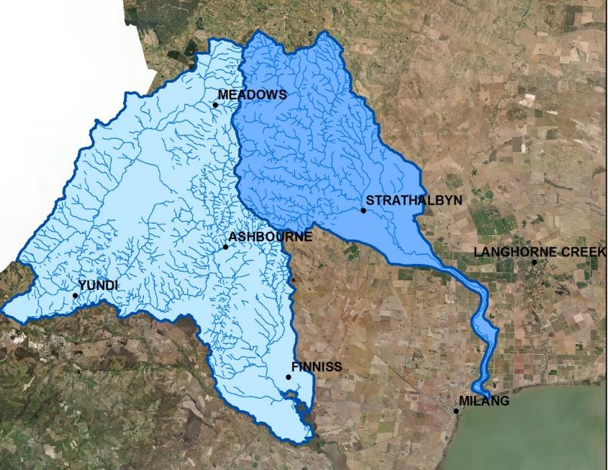
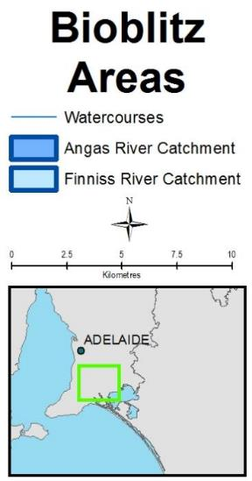
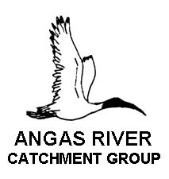
Waterbug BioBlitz
Partners:
Notes:
2nd part of new model –
In Autumn 2016 we ran our first Eastern Mount Lofty Ranges Waterbug Bioblitz
We formed partnerships across community and government. These events led to great conversations between practitioners, community and scientists
Sites were selected within the Angas and Finniss River Catchments - based on community interest, historical sampling and usefulness of data for Natural Resources and DEWNR low flows and WAP projects. Last spring we started the Water bug Bioblitz program in the Marne Saunders River catchment and also ran a Waterbug Bioblitz at Paiwalla wetland!
Steep learning curve but we are getting some excellent results – education, engagement and research

Slide 9
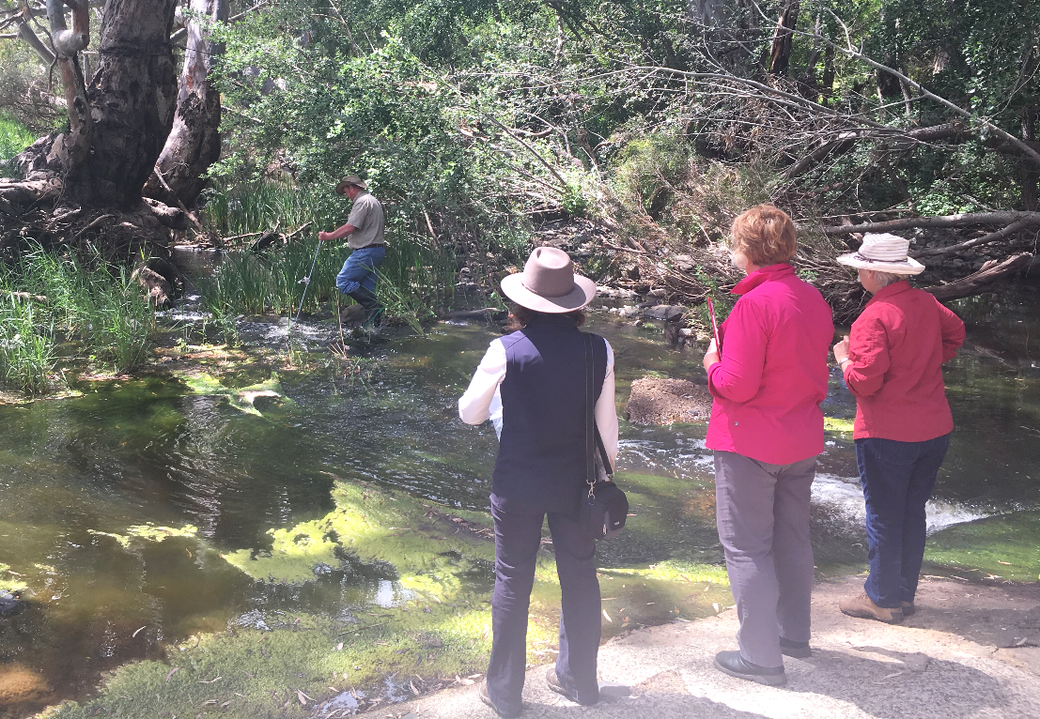
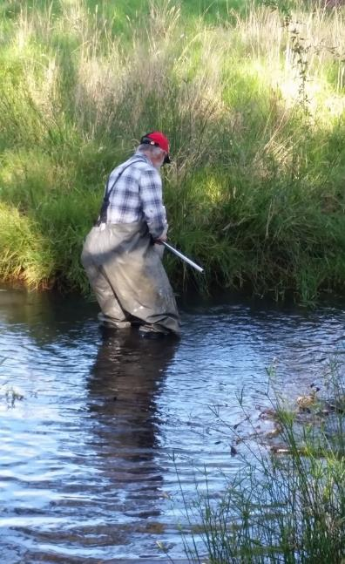
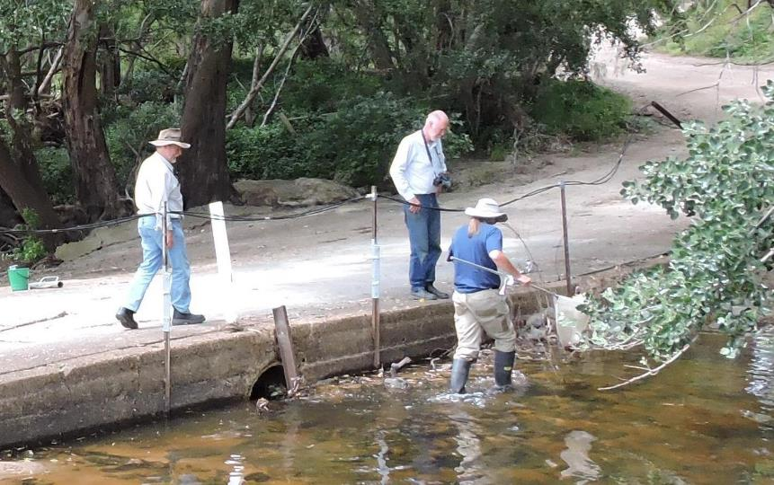
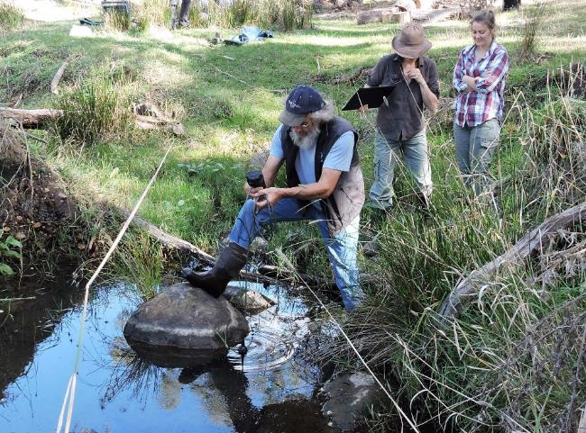
BioBlitz
Pics of collecting
SB
In the Field
Notes:
Sally M – All Stages of the process occur in partnership with trained professionals but overtime the level of guidance for the field process has reduced. Each time we go out members are encouraged to watch the training video to familiarise themselves with the methods. New sites are visited by professionals to help maintain the integrity of the process.
Possibly say this… Another key barrier overcome was the SA Government wader policy which was unnecessarily strict. This was Aestablished for all activities in water including the marine environment where the use of life jackets if water was over 30cm was mandatory. Safe wading procedures are discussed at each Bioblitz but community members can enter the water with waders if it is assessed as safe to do so.

Slide 10
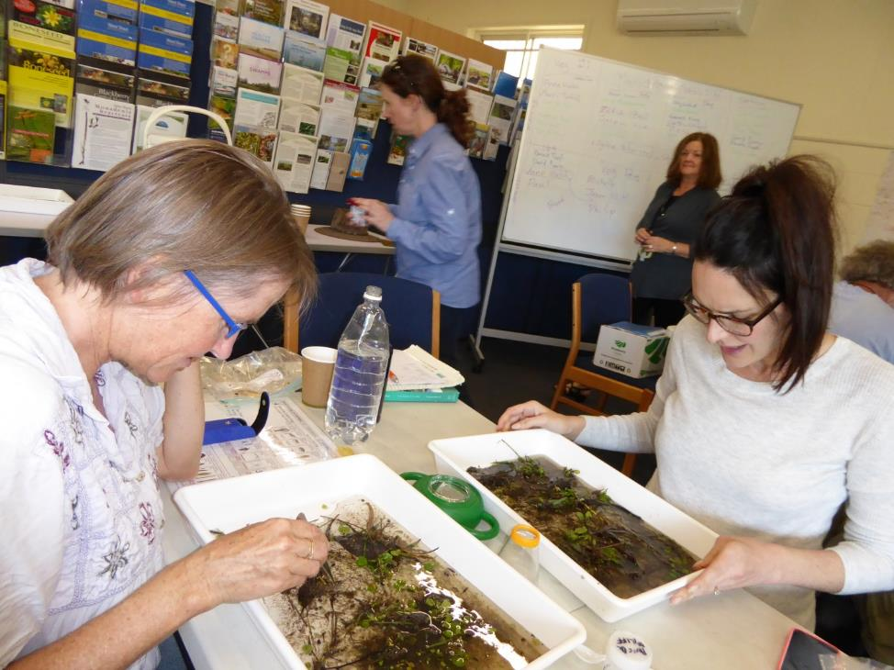
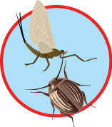
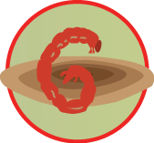
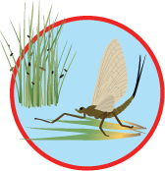
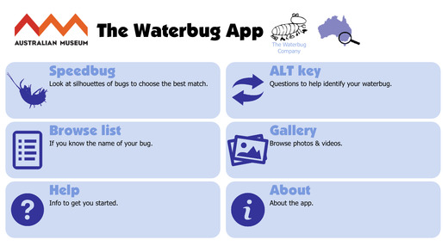
Bioblitz
In the ‘Lab’
Notes:
Sally Maxwell: Sorting of the specimens also occurs in partnership with professionals. Several participants sort and there are professional on hand to confirm id’s and check that trays have had examples of all specimens removed.
The samples are then sent to a laboratory to confirm the field identifications. This is also the stardard practise of the EPA.

Slide 11
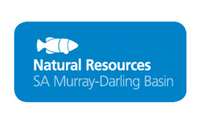

Slide 12
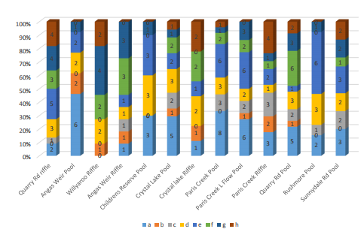
Part 3 - Reporting Back
Co-interpretation (modelled on Vic EPA)
Simple Report Card (modelled on North Central Waterwatch Vic)
Target setting is tricky, most likely use trajectories
Notes:
Graph from report
Getting more buy in from scientists, able to more collaboratively support our corporate goals.
Able to report more meaningful measures of catchment condition such as the composition of trait groups in each sample.

Slide 13
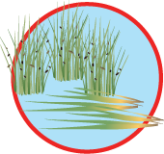
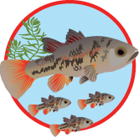
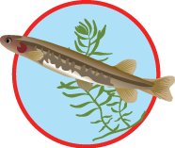
Further data use
Long-Term Condition Monitoring
Water Allocation Planning
Regional Report Cards
Model has proven successful in multiple areas with multiple community groups

Slide 14
The Loop Practitioners
Project Partnership Model
Community
EPA
NRM Board
Govt
Project & Database Design
ALA
The Links Partners
Experts
NRM Board
Trigger actions &/or Project review
Publicity, Recruitment & Training
Community
EPA
Govt
Experts
Experts
Community
NRM Board
Data analysis, Report back, Publicity
Data collection, Moderation & Storage
Govt
EPA
NRM Board
Community
BOM
ALA
Notes:
Citizen Science projects need to be well planned and managed.
The whole Waterwatch project loop with the various stages of a project’s development has been redesigned. From the Project and Database design to the publicity recruitment and training, to data collection, storage and moderation, Data analysis, reporting back to participants and publicity again, and finally deciding what actions need to be taken in light of the findings of the project and review whether the project design needs to be adapted to make sure the project is as effective as possible.
Publicising the project and its findings is really important, as it allows a project to have a much bigger impact. For example the University of Queensland Birds in Backyards project found that many people who didn’t actively take part in the bird surveys but were kept informed of its progress through newsletters and the website also increased their understanding of local birds and altered their backyards in order to attract them.
With so many people involved in Citizen Science projects it is also critical that key partners are involved at the right stages, these are the links in the project.
These include experts, governments including local government, and NRM boards and of course community members. A successful Citizen Science project, encourages input from the Citizens at each stage in the process.

Slide 15
Key outcomes
Increased ability to report the status of aquatic ecological assets through the collection and collation of baseline condition data
An informed section of the community engaged in water planning and contributing to water management outcomes
Increased knowledge and understanding on how to engage the community to aid in the collection of data of suitable quality for evaluation against WAP objectives
Increased capacity of the community to aid in future data collection
Notes:
This program has the ability to faciltate key partnerships between government agencies and the community, helps to build trust and openness in the collection of data to support water allocation planning and other purposes. Data can be used to compare to historical collections.

Slide 16
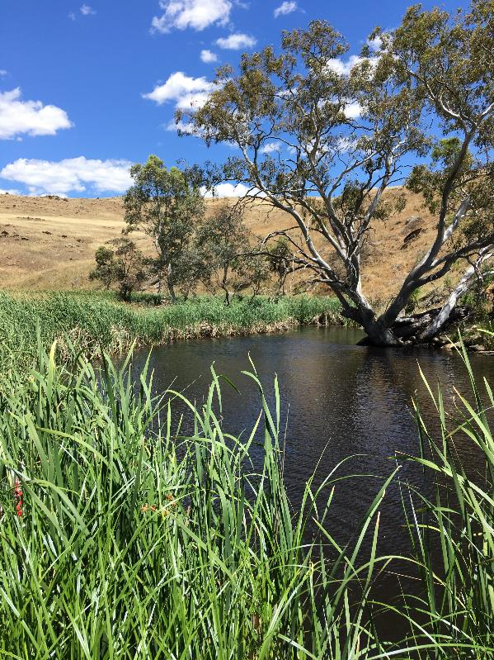
Thanks

Slide 17
Acknowledgements
This project is supported by the
SA Murray Darling Basin Natural Resources Management Board
through funding from the
Australian Government's National Landcare Programme

