Slide 1
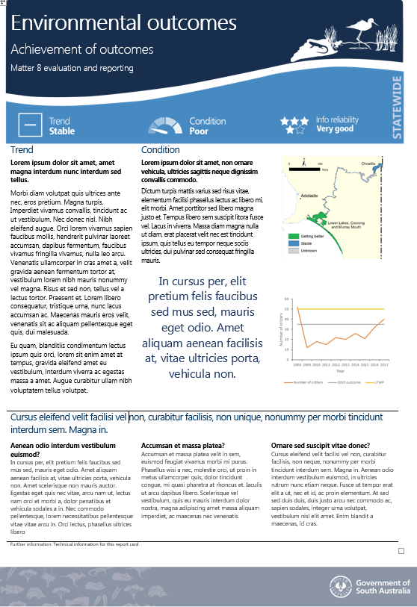
Basin Plan environmental evaluation & reporting
Report on an evaluation
Assess expected outcomes
Respond to evaluation questions
Format = purpose
Information aggregated at the themed asset or whole of asset scale
Notes:
State-based reporting obligation under the Basin Plan
Environmental outcome reporting at an asset scale
We see this as an evaluation and reporting task
CLICK
So our reporting is in fact a report on an evaluation
It was assess progress towards identified expected environmental outcomes
It will also respond to evaluation questions
CLICK
We see this evaluation and reporting task as having multiple purposes
Communicate achievement of environmental outcomes
Inform decision making and adaptive management
Therefore we can think about the format of the reporting in relation to the purposes
THUS we have chosen to develop report cards as a key communication tool to present and communicate the achievement of environmental outcomes
However decision making and adaptive management requires different information, more details, analysis, so the report card will be supported by a technical document/report that will provide this.
So format- relates directly to the purpose
CLICK
One of the key things we have learnt in the last year is related to the scale at which we bring information together
We have multiple expected env outcomes to report on, some relate to spefici species of bird, or fish rerutiment, or flows for an open Murray Mouth, all sorts of things; and we tested presented individual report cards for each of these
Didn’t work – sometimes sent the wrong message, didn’t connect the different aspects of the system, importantly in terms of communication is doesn’t provide a holistic story, just disconnected parts
Working towards themed asset scale or whole of asset scale reporting where multiple waterbird expected outcomes for example are brought together on the one report card about an asset.

